Slide 1
Introduction to Docker
Prashant Kulkarni
June 2016

Slide 2

Agenda
Server Configuration Models
Traditional Server (bare metal)
Virtual Machines
Containers
Demo
Implications for ACI

Slide 3
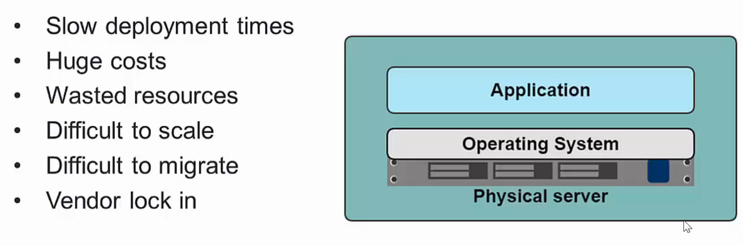
Traditional Machine Setups

Slide 4
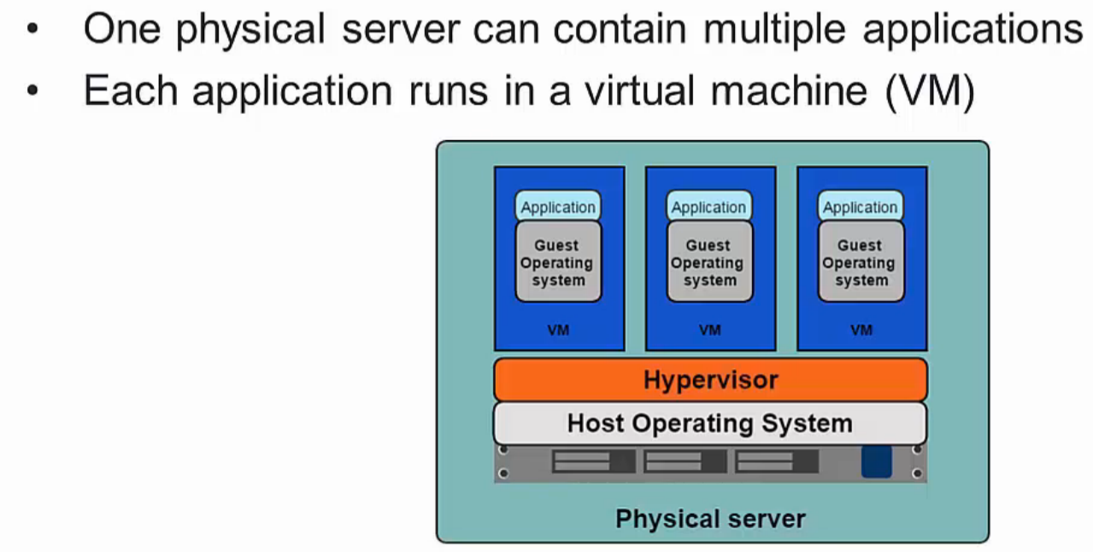
Virtualized Environment

Slide 5
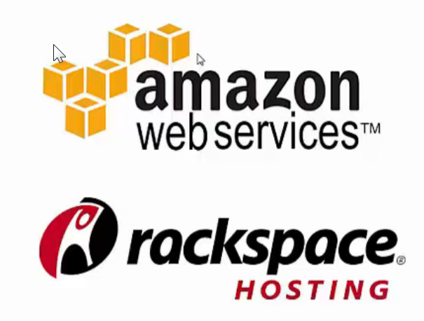
Benefits of VM
Better resource pooling
One physical machine shared among various virtual machines
Easier to Scale
Supports backups/ restore
Support on the cloud/data center
Rapid Elasticity
Pay as you go model

Slide 6
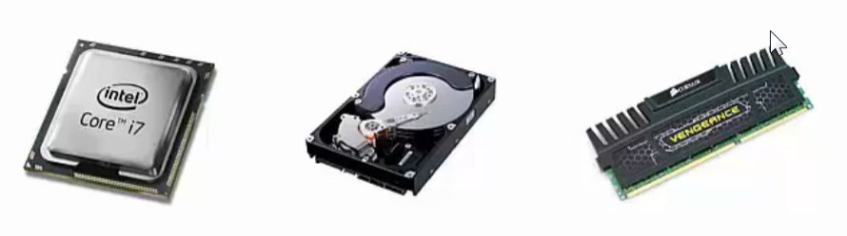
Limitations of VM
Each VM still requires
CPU Allocation
Storage
RAM
Entire guest OS
Wasted resources and Complex Configuration
More VMs you run, more resources you need outside application
Hard to allocate resources to a specific VM on demand
Vendor lock-in
No API standardization

Slide 7
Introducing Containers
The key difference between the container setup and VM based setup is that container-based virtualization uses the kernel of the host OS to run multiple isolated guest instances. These guest instances are called Containers.
By making use of the host operating system’s kernel and not relying on a hypervisor to manage resources, the container stack is far more lightweight than other solutions.
It also allows for completely isolated instances. Each container has its own root filesystem, processes, memory, devices, and network interface.

Slide 8
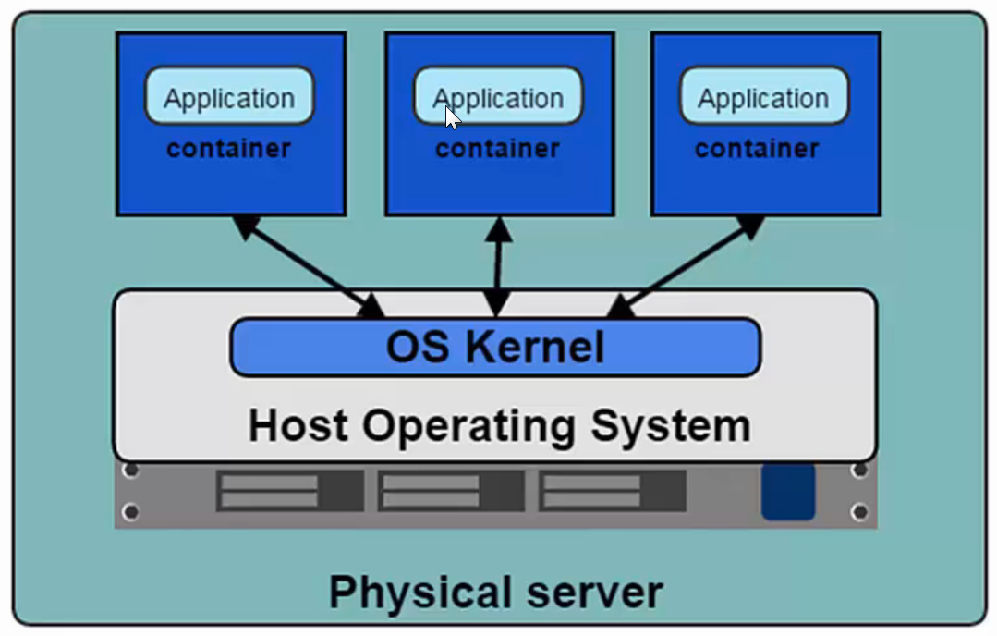
Introducing Container
Containers are the products of operating system virtualization.
Each container has its own
Root file system
Processes
Memory
Devices
Network Ports

Slide 9
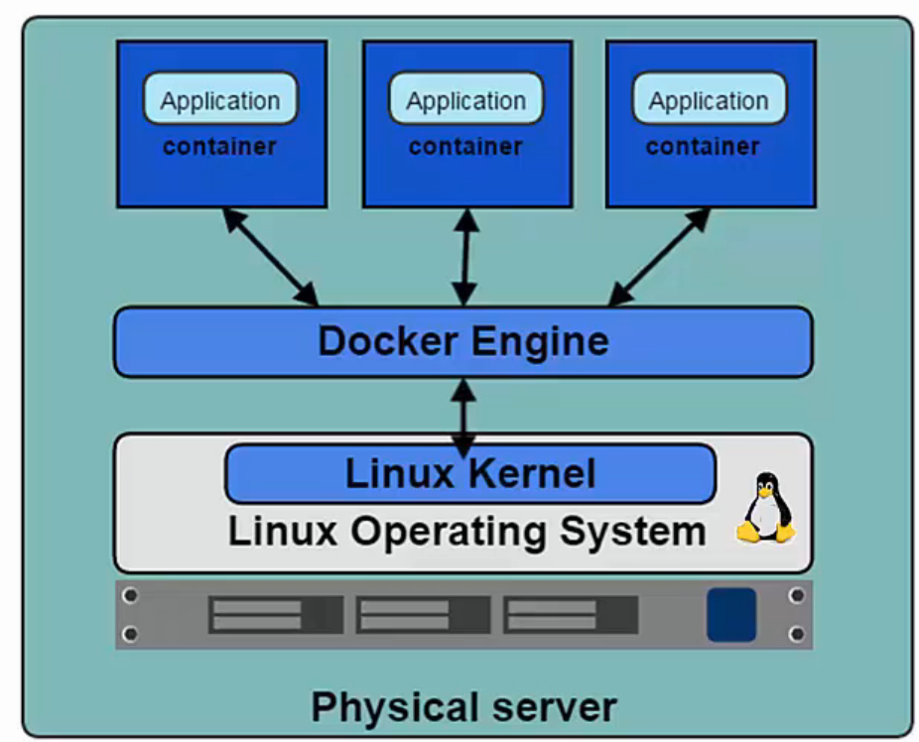
Introducing Docker
Docker is the de facto standard for application containers.
Docker Engine is the program that allows containers to be built, shipped and run
Docker uses Linux Kernel namespaces and control groups and provides isolation

Slide 10
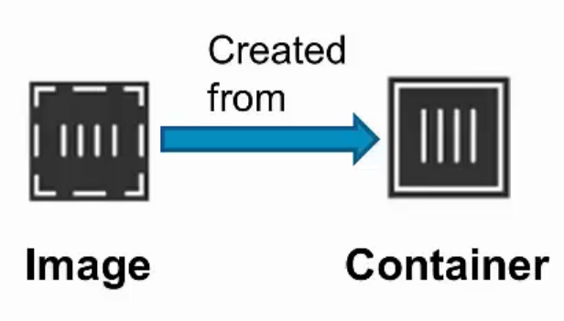
Docker Containers and Images
Images
Read-only templates to create containers
Built by any user
Stored in a common registry for sharing the images
Docker Hub: app store for images
Containers
Isolated, resource controlled and portable operating environment
Contains everything that you need to run app

Slide 11
Docker Orchestration
Docker Machine
Tool that provisions Docker hosts and installs Docker engine on them.
Docker Swarm
Tool that clusters many Docker Engines and schedules containers
Docker Compose
Tool to create and manage multi-container application.

Slide 12


Slide 13
Advantages of Docker
Application Portability:
Docker allows you to package an application with all of its dependencies into a standardized unit for software development.
Built in one platform and ship to another one
Eliminates ‘snowflake server’ situations
Portability from bare metal to VM to private cloud to public cloud
Speed:
Setup | Start Time | Stop Time
Docker Containers | < 50ms | < 50ms
Virtual Machines | 30-45 s | 5-10 s

Slide 14
Advantages of Docker
Additional Level of Abstraction
With Docker one can separate applications from infrastructure and treat infrastructure like a managed application.
Container becomes common abstraction layer (e.g. support multiple app servers)
Improved Resiliency and Robustness:
Swarm/Kubernetes based clustering/orchestration layer can help
Moving the responsibility from application/framework to platform
Enhanced Security/Governance:
Containers are immutable and provide level of abstraction from OS
Image registry helps with traceability/auditing around the image download and usage.

Slide 15
Advantages of Docker
Environment Consistency:
Prebuilt configuration/ lesser configuration needs
Easier upgrades by container replacement
Improved compute utilization/density:
Better control over resources and scaling needs
Higher infrastructure sharing
Virtual Multi-tenancy:
Better isolation and sandboxing can be used to create virtual multi-tenancy

Slide 16
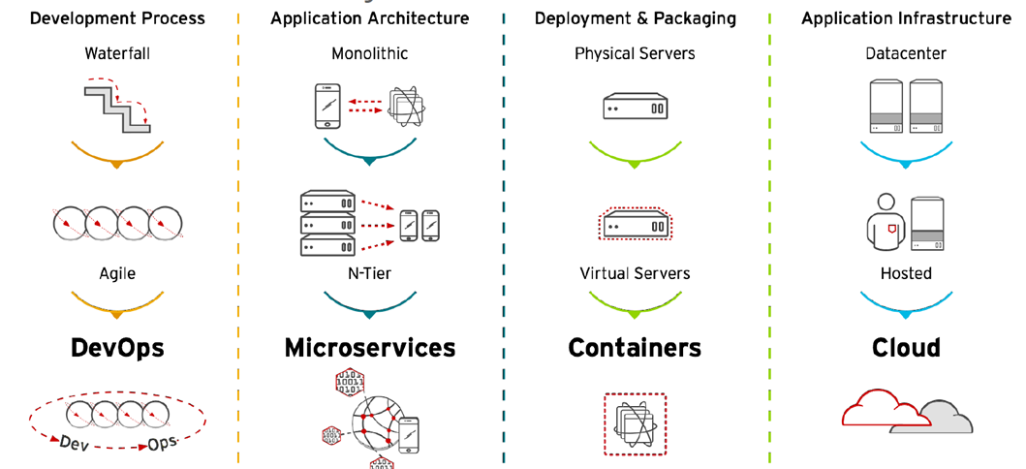
Bringing it all together

Slide 17
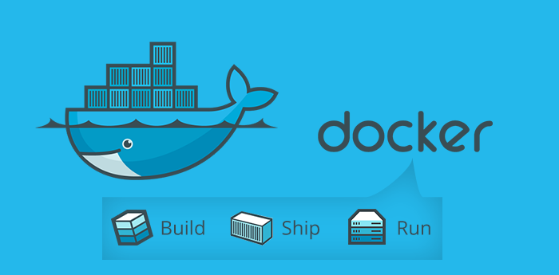
Thank You !

